Slide 1

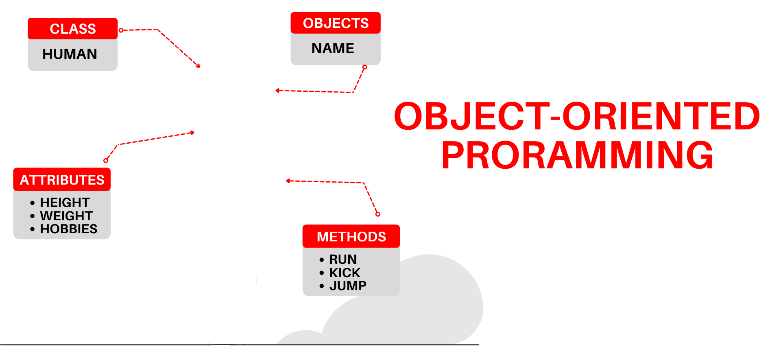

National University of Computer and Emerging Sciences
Spring 2022
Hira Naveed
Lecture # 11 Templates

Slide 2
Functions
Functions make pieces of code reusable by encapsulating them within a function.
e.g. Interchange the values of two int variables x and y.
Instead of inline code: int temp = x; x = y; y = temp;
Write a function: void Swap(int & first, int & second) { int temp = first; first = second; second = temp; }

Slide 3
General Solution
This function gives a general solution to the interchange problem for integers (to exchange the values of any two integer variables):
Swap(x, y);
...
Swap(w, z);
...
Swap(a, b);

Slide 4
But not for doubles…
To interchange the values of two double variables: Cannot use the preceding function; it swaps ints not doubles.
However, overloading allows us to define multiple versions of the same function:
/* Function to swap two double variables */ void Swap(double & first, double & second) { double temp = first; first = second; second = temp; }
The two different Swap functions are distinguished by the compiler according to each function's signature (name, number, type, and order of parameters).
Signature

Slide 5
And for strings…
To interchange the values of two string variables:
Again, overload function Swap():
/* Function to swap two string variables*/ void Swap(string & first, string & second) { string temp = first; first = second; second = temp; }

Slide 6
What about User Defined Types?
And so on ... for other types of variables.
We would have to overload Swap() for each user-defined type:
/* Function to swap two Time class objects */ void Swap(Time & first, Time & second) { Time temp = first; first = second; second = temp; }

Slide 7
Observations:
The logic in each function is exactly the same.
The only difference is in the datatypes
If we could pass the datatype as an argument, we could write a general solution that could be used to exchange the values of any two variables.

Slide 8
Template Mechanism
Declare a datatype parameter (type placeholder) and use it in the function instead of a specific datatype. This requires a different kind of parameter list:
void Swap(________ & first, ________ & second)
{ ________ temp = first; first = second; second = temp; }
template <typename DataType > // type parameter

Slide 9
Template Mechanism
Declare a datatype parameter (type placeholder) and use it in the function instead of a specific datatype. This requires a different kind of parameter list:
void Swap(________ & first, ________ & second)
{ ________ temp = first; first = second; second = temp; }
template <typename DataType > // type parameter
DataType DataType
DataType

Slide 10
Template Mechanism Comments
The word template is a C++ keyword specifying that what follows is a pattern for a function not a function definition.
Originally, the keyword class was used instead of typename in a type-parameter list.
You can use typename or class

Slide 11
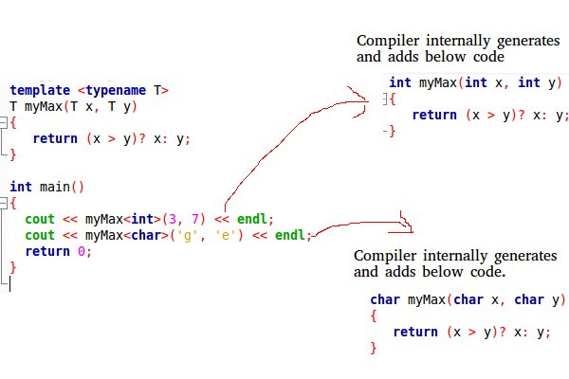
Template Instantiation
The word template is a C++ keyword specifying that what follows is a pattern for a function not a function definition.

Slide 12
Template Instantiation
A function template is only a pattern that describes how individual functions can be built from given actual datatypes.
This process of constructing a function is called instantiation.
We instantiated Swap() four times — with datatypes int, double, string, and Time.
In each instantiation, the template type parameter is said to be bound to the actual datatype passed.
A template thus serves as a pattern for the definition of an unlimited number of instances.

Slide 13
How is a Template Used?
// One function works for all data types. This would work
// even for user defined types if operator '>' is overloaded
template <typename T> T myMax(T x, T y)
{
return (x > y) ? x : y;
}
int main()
{
cout << myMax<int>(3, 7) << endl; // Call myMax for int
cout << myMax<double>(3.0, 7.0)
<< endl; // call myMax for double
cout << myMax<char>('g', 'e')
<< endl; // call myMax for char
return 0;
}

Slide 14
General Form of Template
template <typename TypeParam> FunctionDefinition
or
template <class TypeParam> FunctionDefinition
where:
TypeParam is a type-parameter (placeholder) naming
the "generic" type of value(s) on which the function operates
FunctionDefinition is the definition of the function, using type TypeParam.

Slide 15
Templates with more than one Parameter
Like normal parameters, we can pass more than one data types as arguments to templates.
template <class T, class U>
class A {
T x;
U y;
public:
A() { cout << "Constructor Called" << endl; }
};
int main()
{
A<char, char> a;
A<int, double> b;
return 0;
}

Slide 16
Templates with default Parameter
Like normal parameters, we can pass more than one data types as arguments to templates.
template <class T = int>
class A {
T x;
public:
A() { cout << "Constructor Called" << endl; }
};
int main()
{
A a; // T is an int by default
A<double> b; //T is a double
return 0;
}

Slide 17
Class Templates
The template concept can be extended to classes
Write template before class definition
If the member functions are out-of-line the expression template<class Type> must precede not only the class definition, but each out-of-line function as well

Slide 18
Class Templates
int main()
{
int arr[5] = { 1, 2, 3, 4, 5 };
Array<int> a(arr, 5);
a.print();
return 0;
}
template <typename T>
class Array {
private:
T* ptr;
int size;
public:
Array(T arr[], int s);
void print();
};
template <typename T> Array<T>::Array(T arr[], int s)
{
ptr = new T[s];
size = s;
for (int i = 0; i < size; i++)
ptr[i] = arr[i];
}
template <typename T> void Array<T>::print()
{
for (int i = 0; i < size; i++)
cout << " " << *(ptr + i);
cout << endl;
}
Instantiating class objects

Slide 19
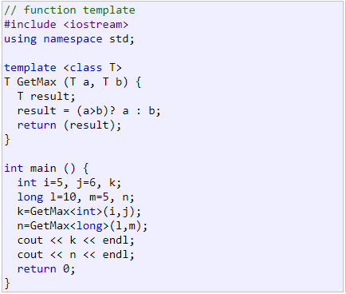

Slide 20
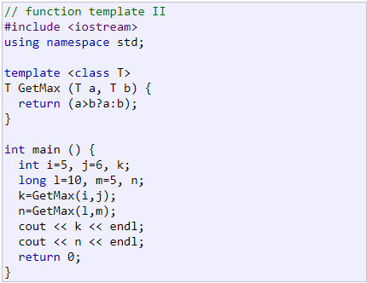

Slide 21
